Slide 1

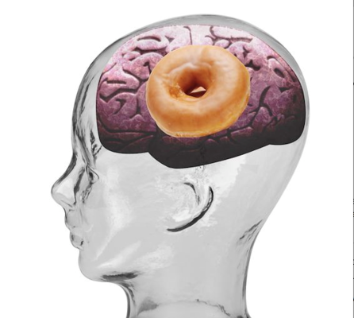


מתוק מעושן: עישון וגמילה לאנשים עם סוכרת
ד"ר אילנה הרמן-בהם
מנהלת מחלקה פנימית ג' ומרפאת סוכרת
מרכז רפואי אוניברסיטאי סורוקה

Slide 2
מה בתפריט הנסיכה?
הקשר בין עישון והופעת סוכרת
השפעת העישון על גליקמיה ואיזון סוכרת
השפעת עישון על סיבוכי סוכרת
האם הפסקת עישון משנה את הסיכון לפתח סוכרת? איזון? סיכון לסיבוכים?
הפסקת עישון בסוכרתיים- הדגשים לגמילה

Slide 3
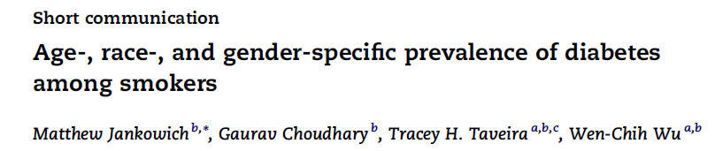
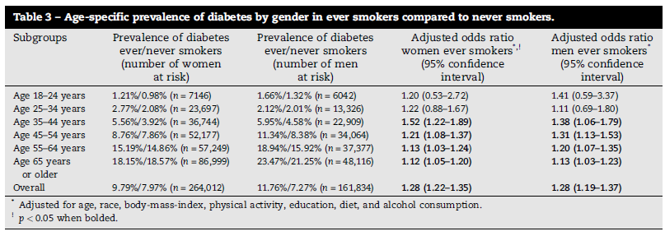


Slide 4
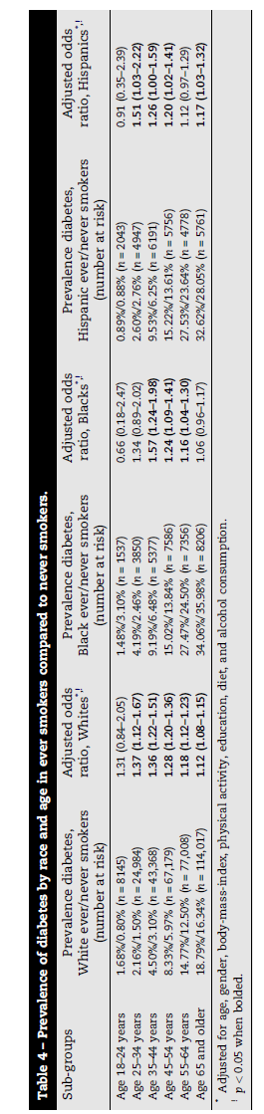

Slide 5
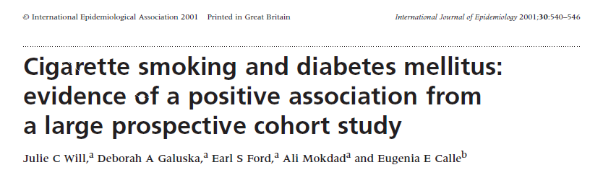
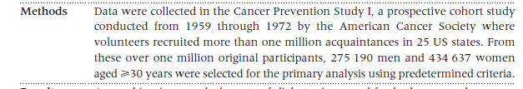
Questionnaires at baseline , 1,3,6,12 years

Slide 6
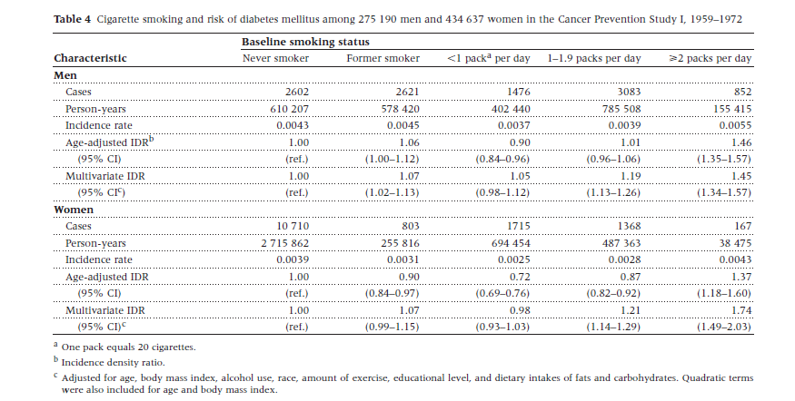

Slide 7
Sex-specific risk ratios for type-2 diabetes mellitus according smoking habits among 275,190 men and 434,637 women
2.50
2.00
Never smoker
<1 Pack per day
1-1.9 Pack per day
>2 Packs per day
1.50
1.00
0.50
0.00
Men
Women
(Will JC. et al., 2001)
Notes:
The Cancer Prevention Study I, a study of the largest number of subjects followed, reported a significant dose-response relation between smoking and risk of diabetes mellitus among middle-aged men and women.

Slide 8
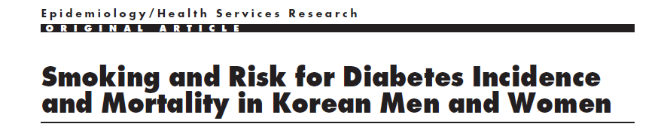
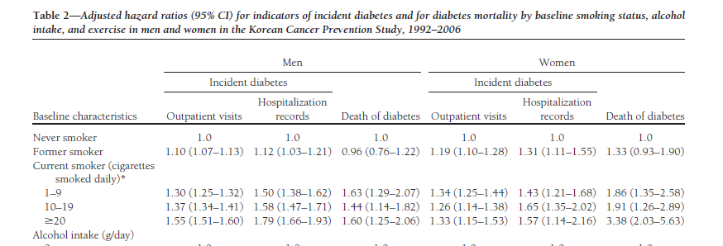
14 year follow up of 1,236,443 people aged 30-95

Slide 9
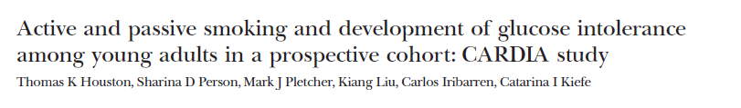
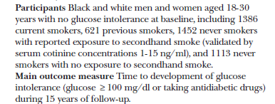
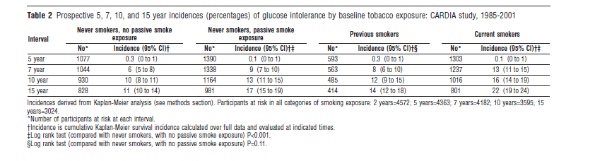

Slide 10
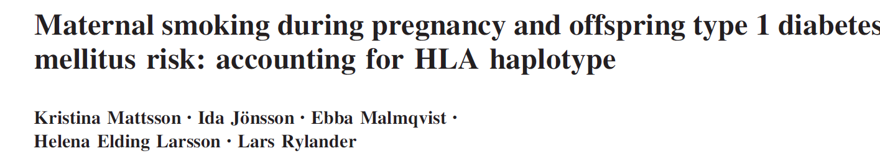
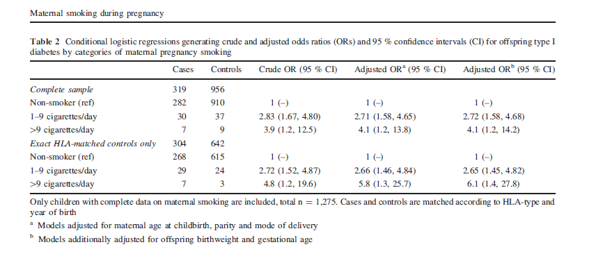

All children born 1999-2005 who developed T1DM by 2013-# 344
3 birth year and HLA matched controls for each T1DM child

Slide 11
מה בתפריט הנסיכה?
הקשר בין עישון והופעת סוכרת –יש!!
השפעת העישון על גליקמיה ואיזון סוכרת
השפעת עישון על סיבוכי סוכרת
האם הפסקת עישון משנה את הסיכון לפתח סוכרת? איזון? סיכון לסיבוכים?
הפסקת עישון בסוכרתיים- תכנית טיפולית כוללנית
מה המנגנון?

Slide 12
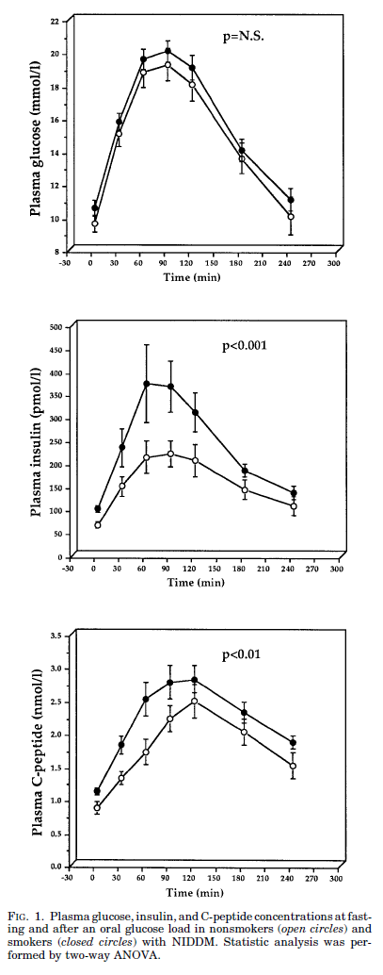
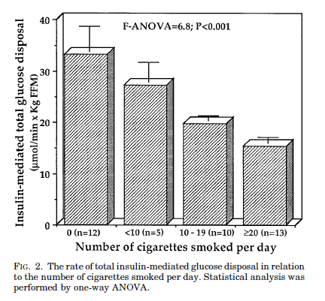
OGTT

Slide 13
One of the possible mechanisms
Smoking
Oxdative stress
Insulin action
Diabetes mellitus
Bridges AB. et al., 1993 Paolisso G, et el., 1993
Notes:
A causal relation between smoking and type-2 diabetes mellitus is plausible, for several reasons. Smoking increases oxidative stress, which has been implicated in the causation of diabetes mellitus.

Slide 14
Possible Mechanisms for the Link
Between Smoking and Diabetes
Smokers are leaner than non-smokers but more central obesity: increased cortisol, decreased testosterone in men, independent effects on estrogen and androgen in women
Increased inflammation and oxidation leading to enhanced insulin resistance
Acute infusion of nicotine increases insulin resistance
Nicotinic receptors on islets and beta cells: decreasing insulin release via neuronal acetylcholine receptors
In animals neonatal exposure to nicotine causes beta cell dysfunction and apoptosis

Slide 16
12% of diabetes can be attributed to smoking

Slide 17
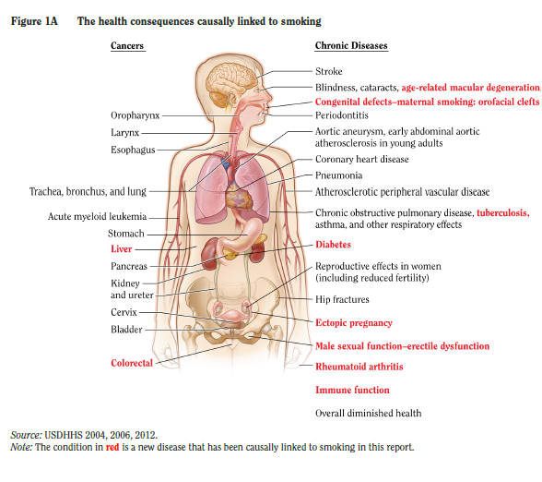
Health Consequences of Smoking

Slide 18



Slide 19
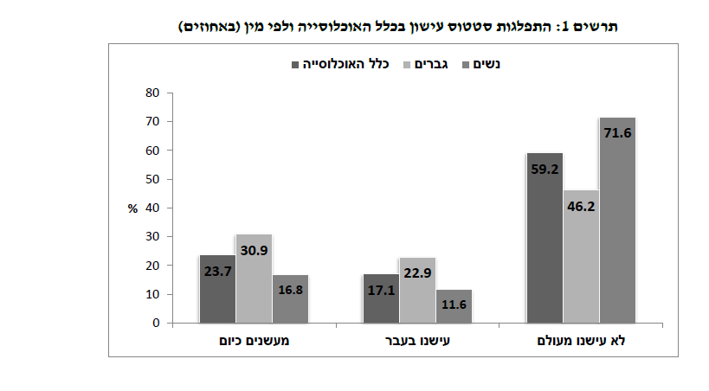

Slide 20
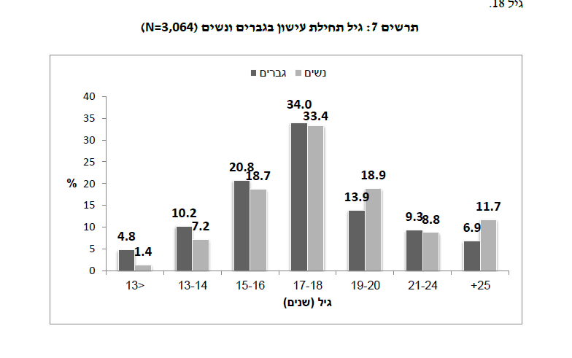

Slide 21
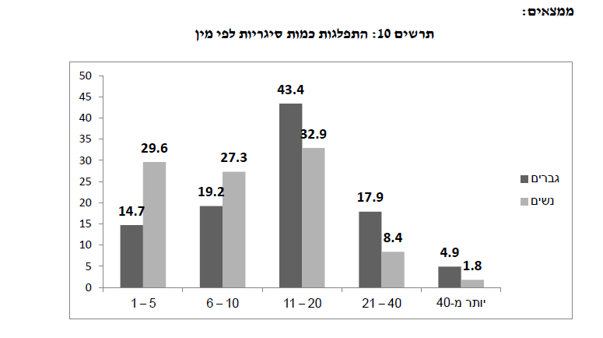

Slide 22
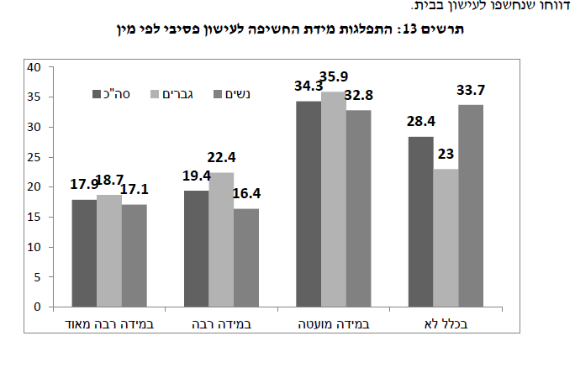

Slide 23


Slide 24
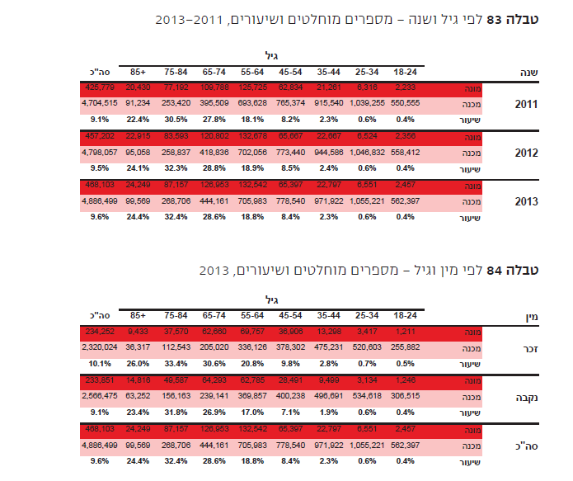

Slide 25
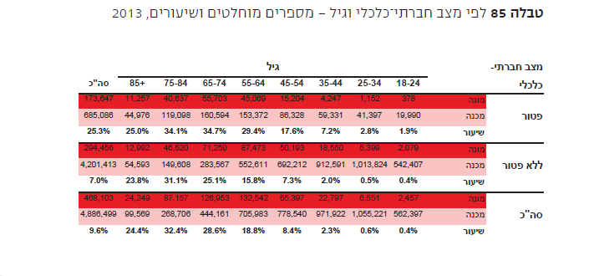

Slide 26
השפעה על רמת סוכר

Slide 27
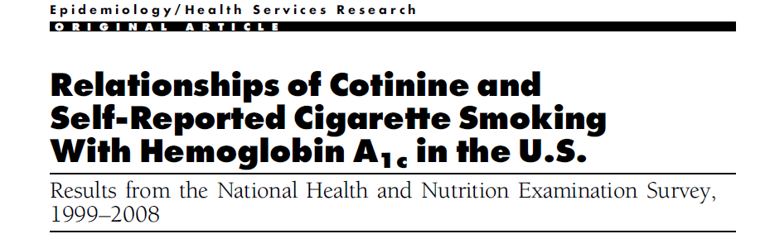
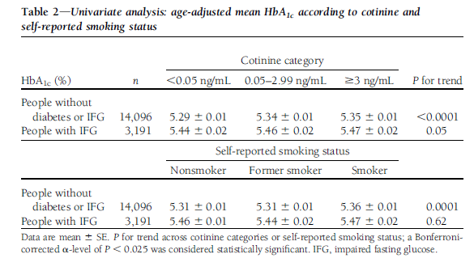

Slide 28
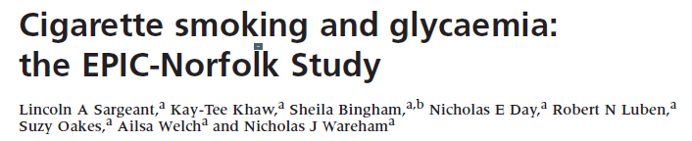

Effects on Glycemia

Slide 29
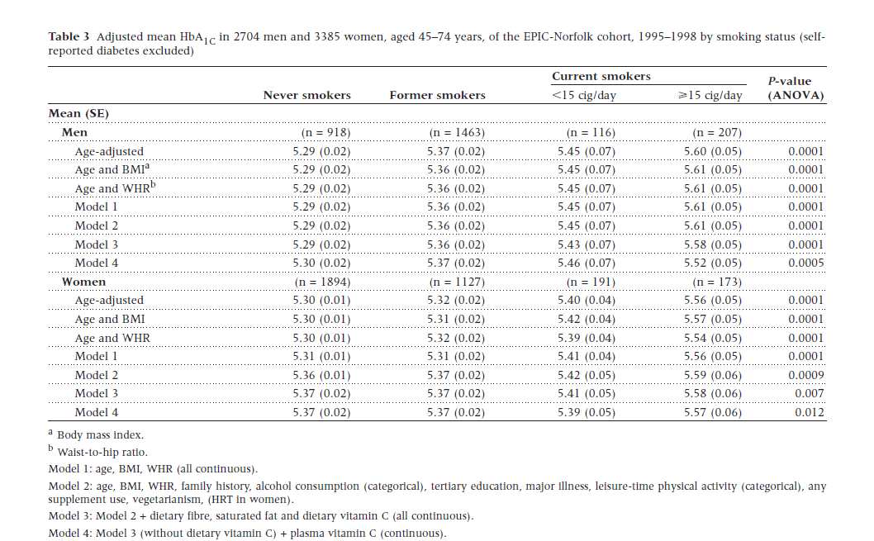
HbA1c

Slide 30
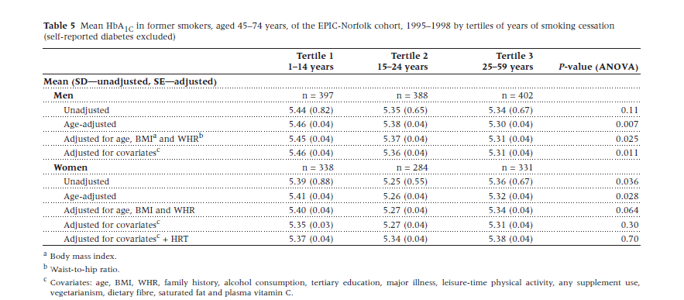
HbA1c by years of smoking cessation

Slide 31
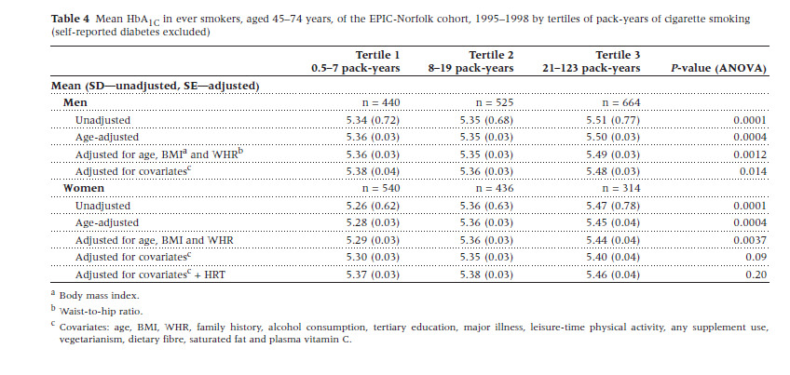
HbA1c by pack-years

Slide 32
מה בתפריט הנסיכה?
הקשר בין עישון והופעת סוכרת –יש!!
השפעת העישון על גליקמיה ואיזון סוכרת- יש!!
השפעת עישון על סיבוכי סוכרת
האם הפסקת עישון משנה את הסיכון לפתח סוכרת? איזון? סיכון לסיבוכים?
הפסקת עישון בסוכרתיים- תכנית טיפולית כוללנית

Slide 33
השפעה על סיבוכים

Slide 34
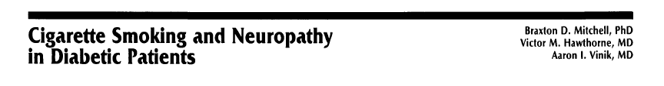
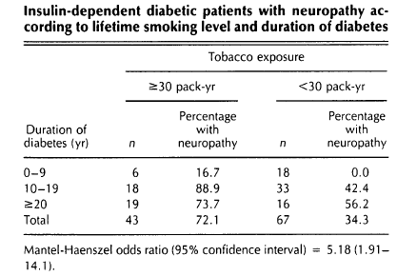
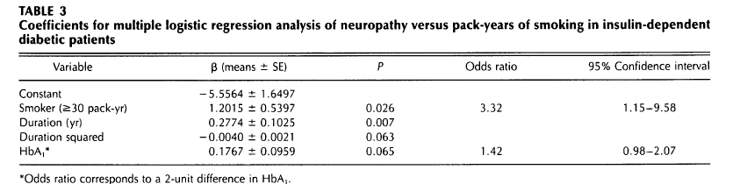
Case -control study of 163 T1DM and 166 T2Dm
No relationship in T2DM

Slide 35

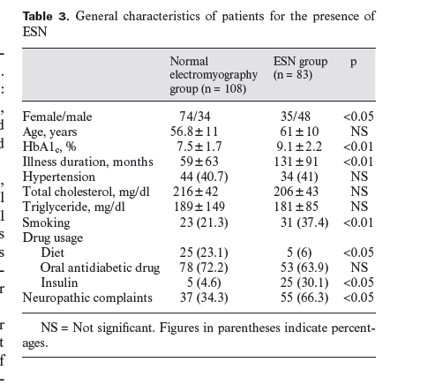
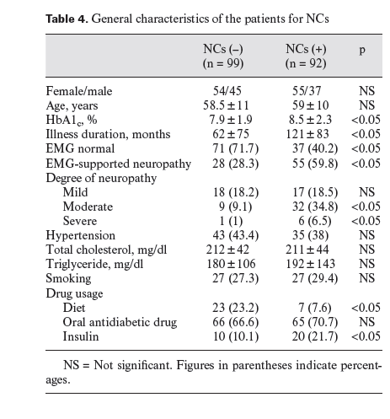

EMG
191 T2DM
Neuropathic Complaints

Slide 36
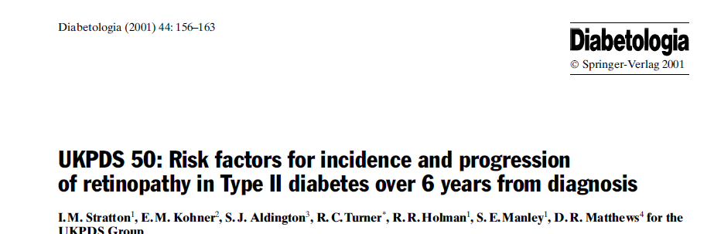
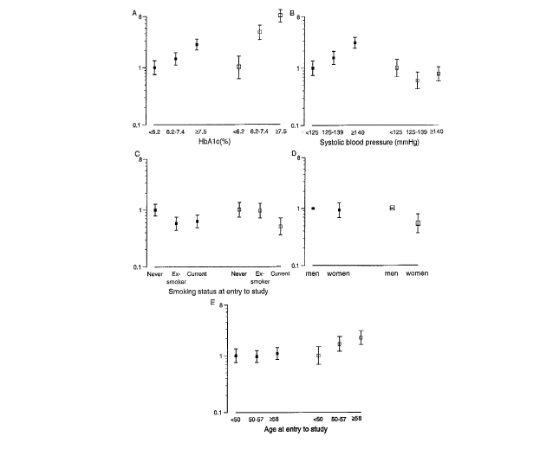
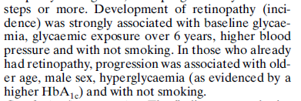

Other studies – no correlation

Slide 37
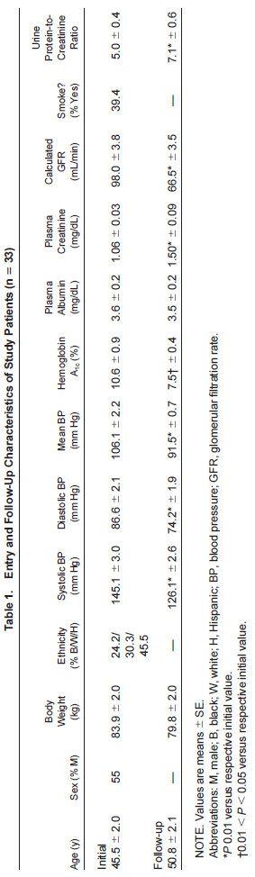


Slide 38
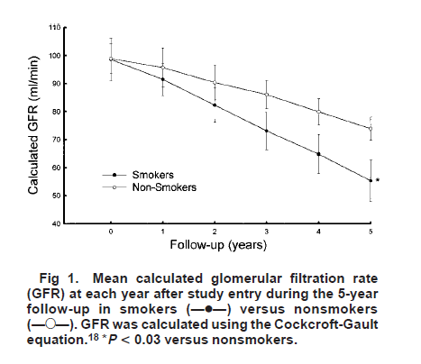
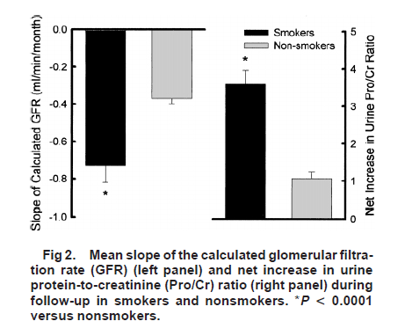
Results
eGFR
eGFR Pro/Creat-U
19 non smokers
10 smokers

Slide 39
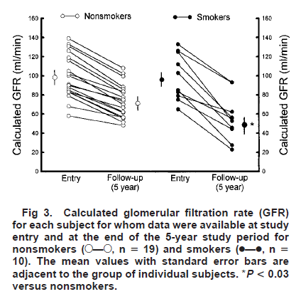
HbA1c
10.5-7.4 NS
10.7-7.6 S
Mean BP
107/92 NS
105/91 S
Cigarette smoking was the only predictor of more rapid decline

Slide 40
Mechanisms of Smoking-induced Renal Damage
Nicotine and CO induced
Tachycardia
hypertension
vasoconstriction
Direct endothelial damage
Increased viscosity and platelet aggregation
Mesangial proliferation- ROS,phenol glycoproteins leading to local inflammation

Slide 41
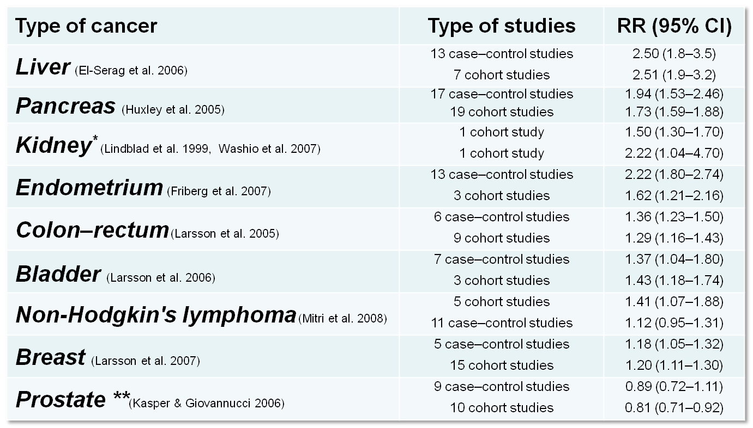
Diabetes and Cancer Risk
**NHF1 polymorphism that is associated with DM protects against prostatic CA
Vigneri et al. Endocr Relat Cancer 2009;16:1103-23

Slide 42
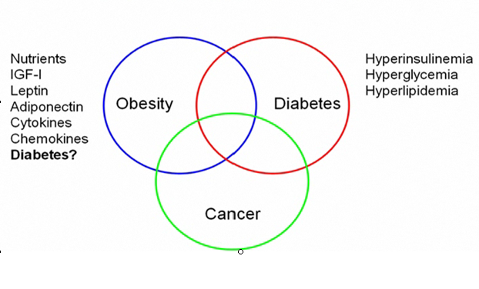
How do Obesity and Diabetes Affect Cancer Development?

Slide 43
Risk Factors For Cancer in Diabetes
Obesity, especially visceral
Hyperinsulinemia +/- insulin resistance
Hyperglycemia
Oxidative stress
Chronic inflammation
Altered sex-steroid metabolism
Vigneri P et al. Endocr Relat Cancer 2009;16:1103
*NAFLD: non-alcoholic fatty liver disease

Slide 44
Possible Mechanisms for the Link
Between Smoking and Diabetes
Smokers are leaner than non-smokers but more central obesity: increased cortisol, decreased testosterone in men, independent effects on estrogen and androgen in women
Increased inflammation and oxidation leading to enhanced insulin resistance
Acute infusion of nicotine increases insulin resistance
Nicotinic receptors on islets and beta cells: decreasing insulin release via neuronal acetylcholine receptors
In animals neonatal exposure to nicotine causes beta cell dysfunction and apoptosis

Slide 45
Obesity Diabetes and Smoking Affect Cancer Development!
Smoking

Slide 46
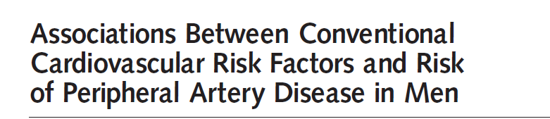
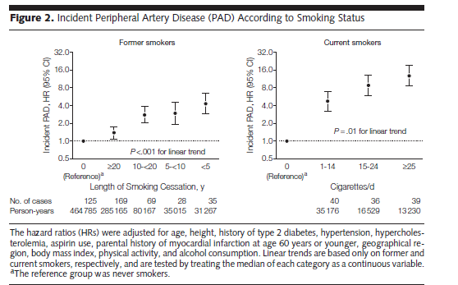

Slide 47
Risk of Ulcers and Amputations
Comorbid conditions
  microvascular, macrovascular disease
Patient education and self-care practices
Tobacco and alcohol use
Cigarette
smoking
PVD
Amputation
Notes:
Tobacco and alcohol use have been shown to be risk factors for foot ulcers and lower extremity amputations in persons without diabetes. Because patients with diabetes have been excluded from these important studies, it is assumed that there is similar pathophysiology in both persons with and without diabetes.

Slide 48
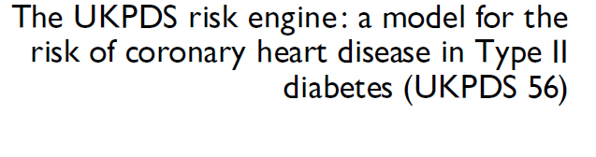
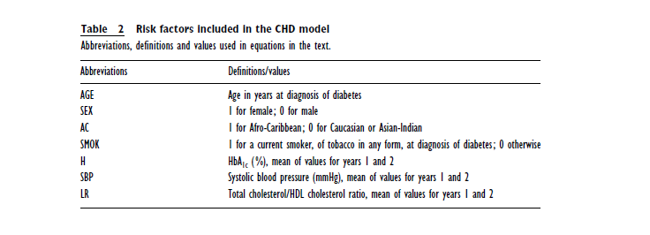


4450 people with new onset diabetes

Slide 49

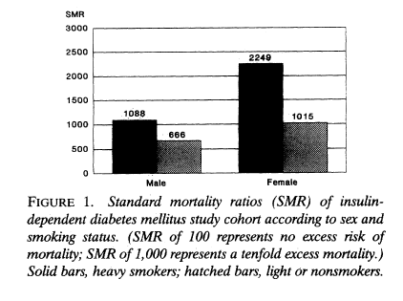
Pittsburg Registry 723 T1DM: 7 year follow up
S
NS
S
NS

Slide 50
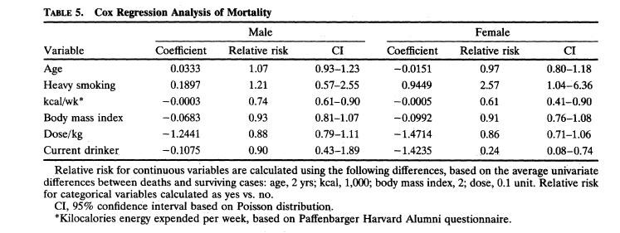
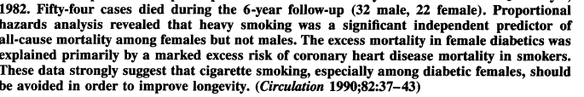

Slide 51



Slide 52
מה בתפריט הנסיכה?
הקשר בין עישון והופעת סוכרת –יש!
השפעת העישון על גליקמיה ואיזון סוכרת- יש!
השפעת עישון על סיבוכי סוכרת- יש!
האם הפסקת עישון משנה את הסיכון לפתח סוכרת? איזון? סיכון לסיבוכים?
הפסקת עישון בסוכרתיים- תכנית טיפולית כוללנית

Slide 53
השפעה של הפסקת עישון

Slide 54




Slide 55



Study Aim
Study Design
Eur J Cardiovasc Prev Rehabil
Notes:
Eur J Cardiovasc Prev Rehabil
14:244–249 c 2007 The European Society of Cardiology

Slide 56


Data Collection
8yr Alternate Year Clinic Visit
+ B.Tests
Notes:
Table 1 shows good enough demographic and clinical characteristics which are similar or statistically different but with small effective difference between the compared groups.
From :
Eur J Cardiovasc Prev Rehabil
14:244–249 c 2007 The European Society of Cardiology

Slide 57

Results :
Notes:
Risk ratio were higher when baseline fasting glucose level was over 100 and BMI over 23 but multivariate analysis did not show any effect of controlling for blood pressure and cholesterol level together with other covariates already controlled for.
From :
Eur J Cardiovasc Prev Rehabil
14:244–249 c 2007 The European Society of Cardiology

Slide 58
*
*
*
*Significant
Years post Cessation
Cigarettes / Day
Adjusted for age, baseline fasting glucose, weight change, baseline BMI, family Hx of DM, alcohol consumption and exercise.
Notes:
Smoking has been known for more then 40 years to be linked with a tendency to develop diabetes but the mechanism is still not fully understood and thought to be mostly due to insulin resistance in smokers.
(First study to show link by our own Jack Medally)
Ex smokers in general did not have more diabetes (risk ratio 0.98 CI 0.81-1.17) then smokers (risk ratio 1.62 95% CI 1.40-1.88) when compared to non smokers, when smoking status was based on a simple declaration. But when a questionnaire was filled by patients every 2 years on their smoking status a dose responsive curve was found and 4 years cessation was already not-significant regarding the tendency for DM.
From :
Eur J Cardiovasc Prev Rehabil
14:244–249 c 2007 The European Society of Cardiology

Slide 59


randomization
Data Collection -ARIC
17 years follow up from 1987-2004
Annual phone call interview
Continues
Home visit from 87-89
9yr Annual phone interview & Clinic visit
every 3 yrs at approx’ :
1991 1994 1997
Notes:
Persons with higher cumulative smoking exposure were significantly more likely to be male, white and less educated and to have a higher leukocyte count and waist to hip ratio but lower BMI (All p for linear trend < 0.001)
From:
Ann Intern Med. 2010;152:10-17.
Also from :
Atherosclerosis Risk in Communities Study: Community Surveillance and Cohort Morbidity/Mortality Follow-Up. Accessed at : http://www.cscc.unc.edu/aric/visit/General_Description_and_Study_Management.5_1.pdf

Slide 60

Results :
HR for DM in Smokers
<13 py 1.09 (CI, 0.92 to 1.28)
14-30 py 1.38 (CI, 1.18 to 1.61)
>30 py 1.42 (CI, 1.20 to 1.67)
Comp Never Smoked
less gain in weight
Less Increase in waist circumference
Greater decreases in diastolic blood pressure
Ann Intern Med. 2010;152:10-17.
Notes:
Compared with persons who never smoked, those who continued to smoke had less gain in weight and waist circumference, greater decreases in diastolic blood pressure and HDL cholesterol level, and a greater increase in leukocyte count. This means that the tendency for diabetes in smokers is not related directly to weight gain or hip to waist ratio changes but maybe to insulin resistance as shown in other places.
From :
Ann Intern Med. 2010;152:10-17

Slide 61

Results :
HR for DM s/p Stopping Smoking
(After 1st 9 years Compared to never smoked) :
Former 1.16 (CI, 0.99 to 1.36)
6-9 yr 1.21 (CI, 0.89 to 1.65)
3-5 yr 1.54 (CI, 1.10 to 2.14)*
0-3 yr 1.80 (CI, 1.44 to 2.25)*
Current 1.26 (CI, 1.08 to 1.46)
* Significant
Notes:
Adults who quit smoking between baseline and visit 2 had significantly lower body weight, smaller waist circumference, lower HDL cholesterol
level, higher triglyceride level, lower blood pressure, and higher leukocyte count at baseline than their counterparts who never smoked.
Prospectively, these new quitters, compared with persons who never smoked, had more significant increases in weight, waist circumference, and fasting glucose level.
Long term effect was measured by ohonecall interview upto 2004 and only cessation in the last 3 years of the first 9 years follow up was related to increase in diabetes
From :
Ann Intern Med. 2010;152:10-17

Slide 62

Risk For DM among New-Quitters :
Men 1. Age > 60 2. Weight Gain > 4kg 3. Cigarettes per Day > 20 4. High WBC
Women Weight Gain > 4kg & High WBC
Notes:
Risk factors for DM among new Quitters were – for men age 60 years or older at visit 2, smoked 20 or more cigarettes per day before quitting, and gained more than 4 kg between baseline and visit 2 (hazard ratio, 3.44 [CI, 1.07 to 11.04]) , and for women new quitters, those who smoked fewer than 20 cigarettes per day before quitting but gained more than 4 kg between baseline and visit 2 had the highest diabetes risk (hazard ratio, 2.69 [CI, 1.25 to 5.79]).
The highest diabetes risk in quitters occurred during the first 3 years after quitting (hazard ratio, 1.89 [CI, 1.26 to 2.82]), then gradually decreased until no excess risk was seen at 12 years.
From :
Ann Intern Med. 2010;152:10-17

Slide 63
To Summarize
The more you smoke – The bigger chance you have at contracting diabetes mellitus !
RR ≈ 1.4 (>14 Cig/Day)
RR ≈ 1.6-1.75 (>10 Cig - >20 Cig / Day)
New quitters ≈ diabetes mellitus !
RR ≈ 2.0 & NNH=45 (During first 2-3 years),
Risk factors -men and women :
Weight gain > 4 KG
Leucocytosis - Smokers’ baseline inflammatory state
Amount smoked >20 Cig/day

Slide 64


15 T2DM who stopped smoking
16 T2DM controls who continued smoking

Slide 65

Body Weight

Slide 66


Glycemic Control
HbA1c
FPG

Slide 67

Blood Pressure

Slide 68


Predictors of Change in HbA1c
BMI
TG
Increase in Body Weight
Insulin resistance rather than weight predicts metabolic deterioration after smoking cessation!

Slide 69


Metabolism (60)10:1456-64

Slide 70



Slide 71


Slide 72


Slide 73


Slide 74


Slide 75


Slide 76
מה בתפריט הנסיכה?
הקשר בין עישון וסוכרת –יש יותר סוכרת בקרב מעשנים
השפעת העישון על גליקמיה ואיזון סוכרת- עישון משפיע על רמת הסוכר(HbA1c) בבריאים ,טרום סוכרתייםוסוכרתיים
השפעת עישון על סיבוכי סוכרת- עישון משפיע על התהוות והתקדמות סיבוכ סוכרת ותמותה
האם הפסקת עישון משנה את הסיכון לפתח סוכרת? כן-אבל לוקח שנים
איזון? לא
סיכון לסיבוכים והתקדמותם? מיקרו-כן
מאקרו-כן/לא
הפסקת עישון בסוכרתיים- תכנית טיפולית כוללנית

Slide 77
מה בתפריט הנסיכה?
הקשר בין עישון והופעת סוכרת –יש!
השפעת העישון על גליקמיה ואיזון סוכרת- יש!
השפעת עישון על סיבוכי סוכרת- יש!
האם הפסקת עישון משנה את הסיכון לפתח סוכרת? כן-אבל לוקח שנים
איזון? לא
סיכון לסיבוכים והתקדמותם? מיקרו-כן
מאקרו-כן/לא
הפסקת עישון בסוכרתיים- תכנית טיפולית כוללנית

Slide 78
תכנית להפסקת עישון

Slide 79


Treatment of Diabetes
Target Obesity When Treating Glycemia!
Start Early
Avoid Hypoglycemia

Slide 80




Slide 81


Slide 82



Slide 83


Slide 85


Risks of smoking and passive smoking are at least equivalent to those in non-smokers
Heightened risk for CVD, premature death and microvascular complications

Slide 86


Slide 87

Identify stage of change
Behavioral therapy
Cognitive therapy
Medications
Be aware of weight gain and depression and put in place strategies to avoid them including meds and
HALT!!- don’t get too Hungry, Angry, Lonely
or Tired

Slide 88


Where is smoking cessation?

Slide 89
Smoking Cessation Programs
Screen quitters for diabetes!!!

Slide 90




Slide 91

יש להשיג את כל היעדים!!!!
OBESITY
SMOKING

Slide 92



דע מאין אתה בא ולאן אתה הולך.............

Slide 93



Slide 94

תודה רבה

